Slide 1
Online Member Directory

Slide 2
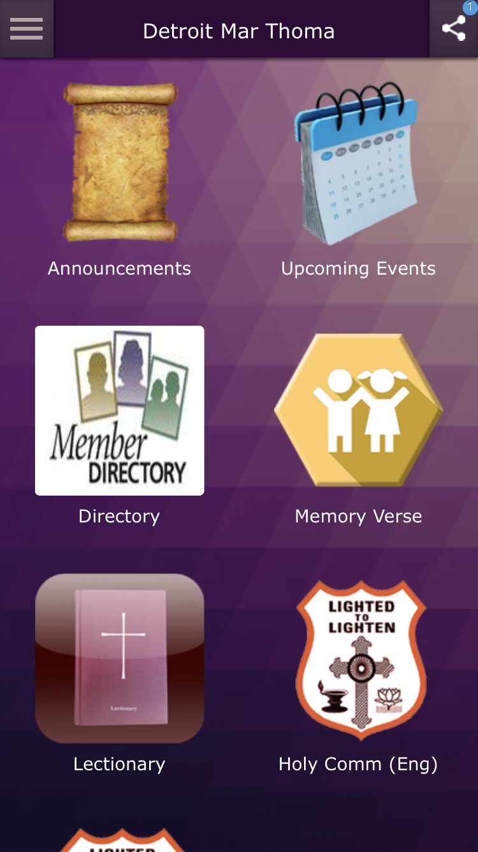
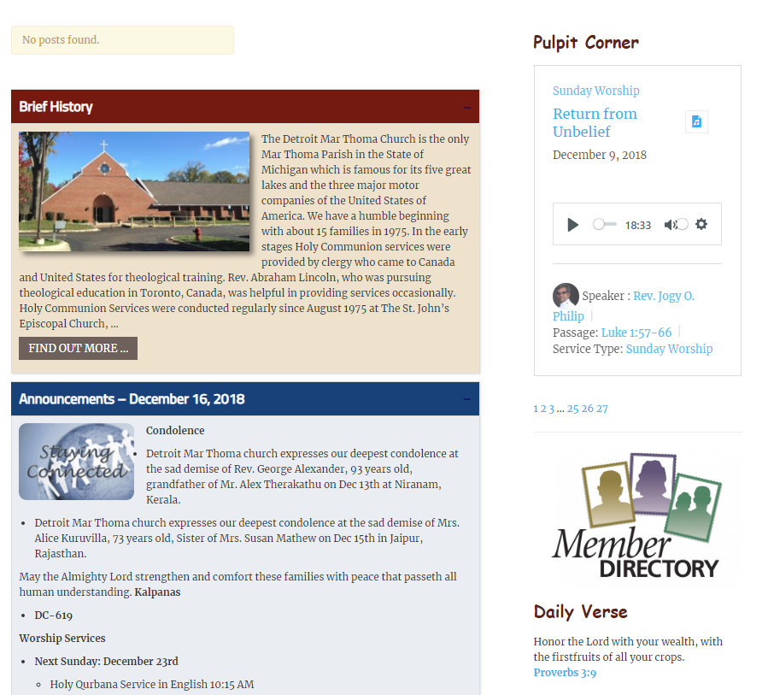
Available both in the Phone App as well as on the Web-page
Access Code
Required
48033
(will change every 6 months)

Slide 3
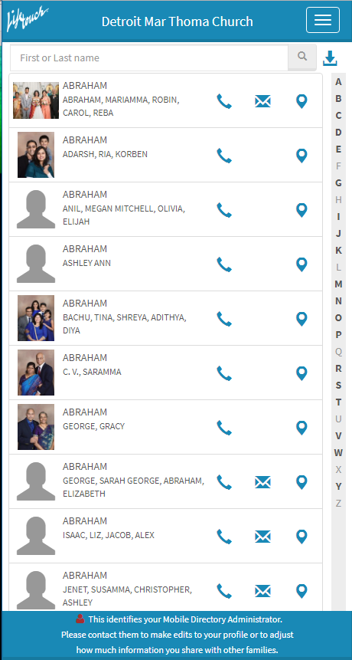
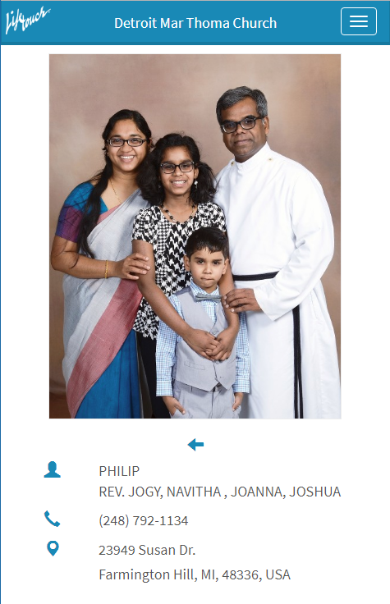
Click to call phone
Click for direction mapping

Slide 4
For any update to your information contact:
Our Vicar (Rev. Jogy O. Philip)
Secretary (Mr. Alan John)

